Slide 1
Space Analysis: Subway Cars
BY HOLLY PARKIN

Slide 2
What kinds of functions does a subway car serve?

Slide 3
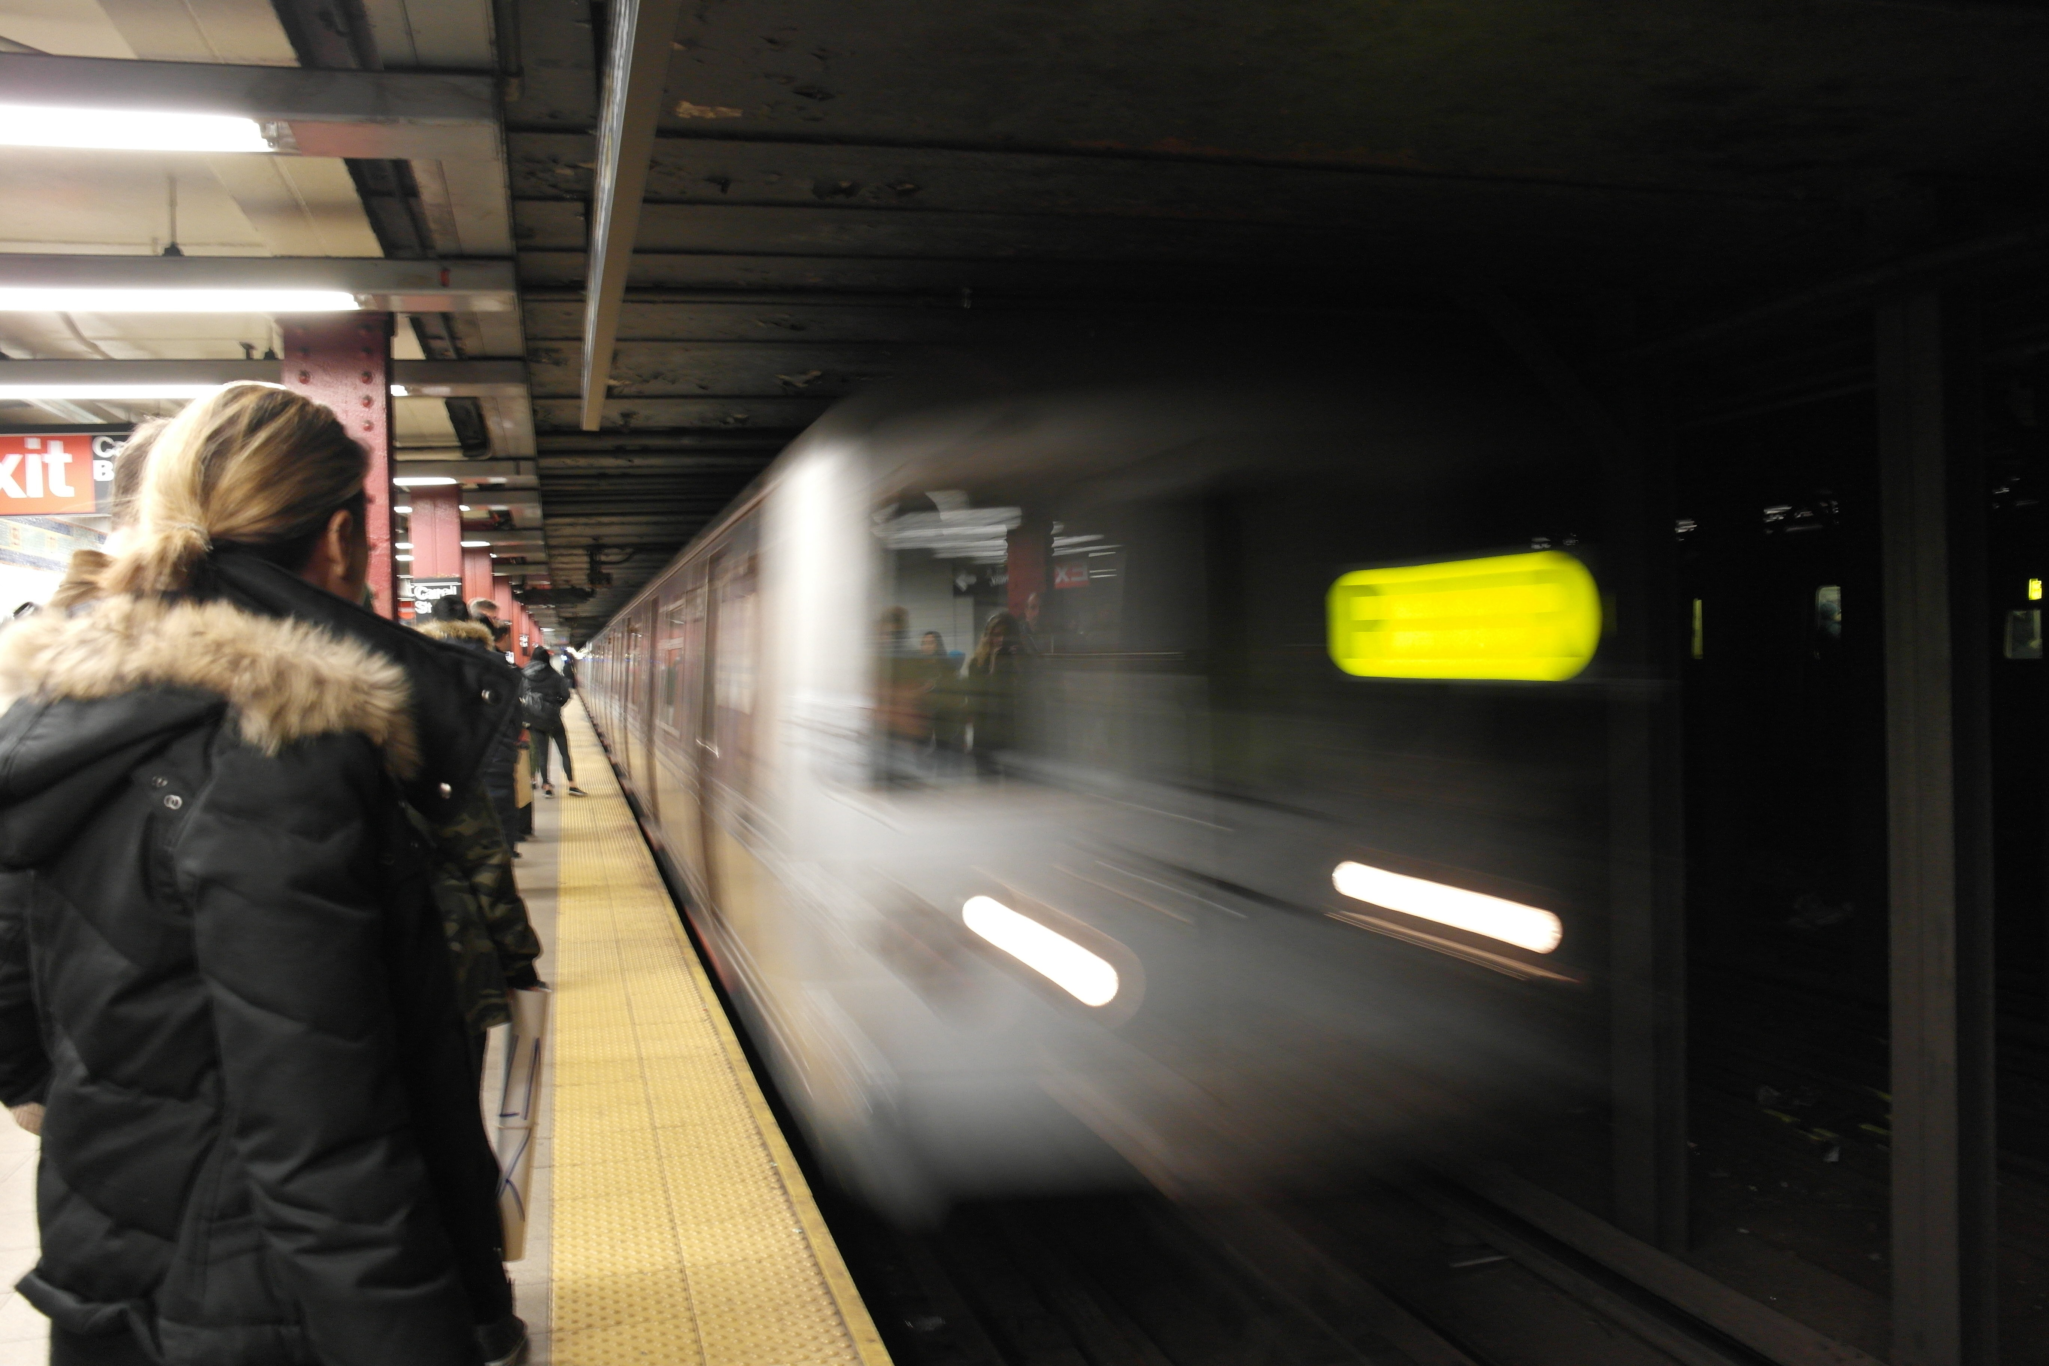
Transportation

Slide 4
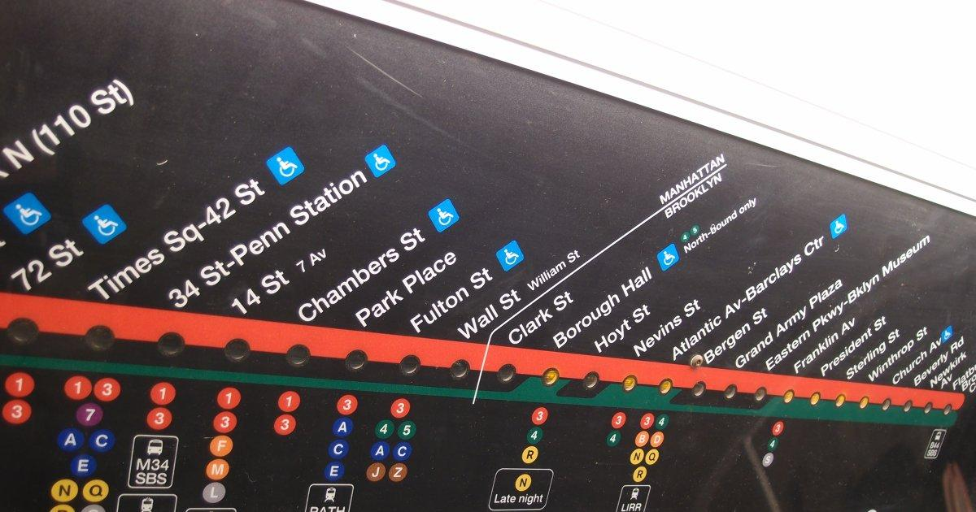
Finding directions

Slide 5
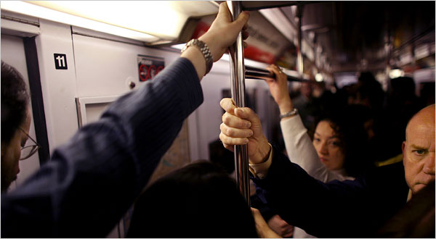
Crowd control

Slide 6
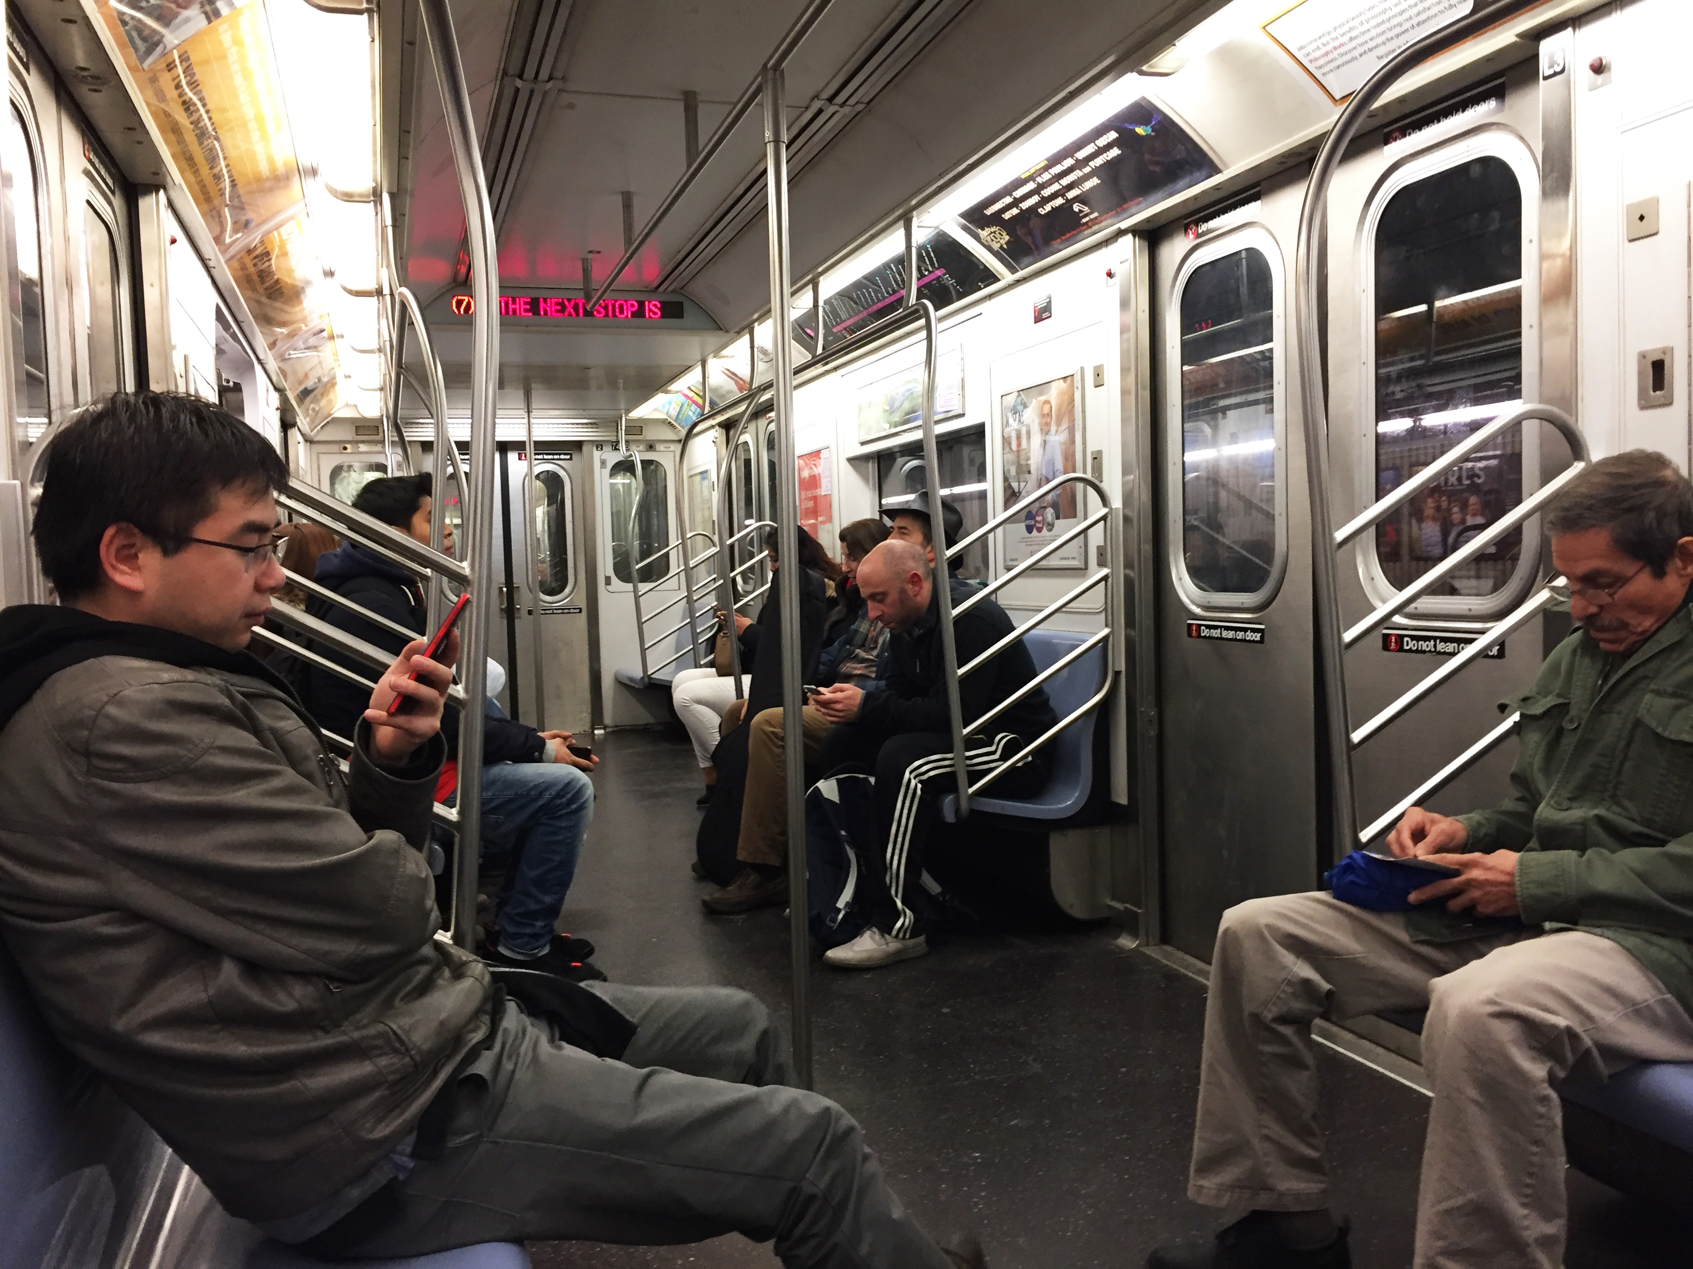
Sitting/resting

Slide 7
But what other functions can a subway car serve?

Slide 8
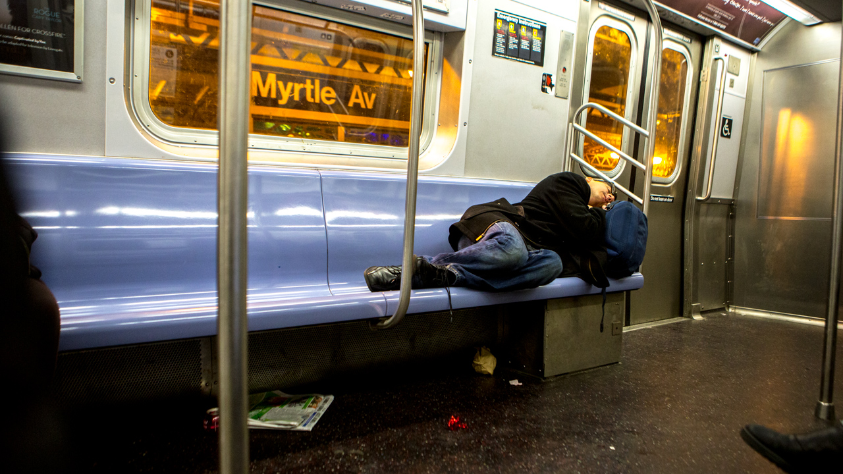
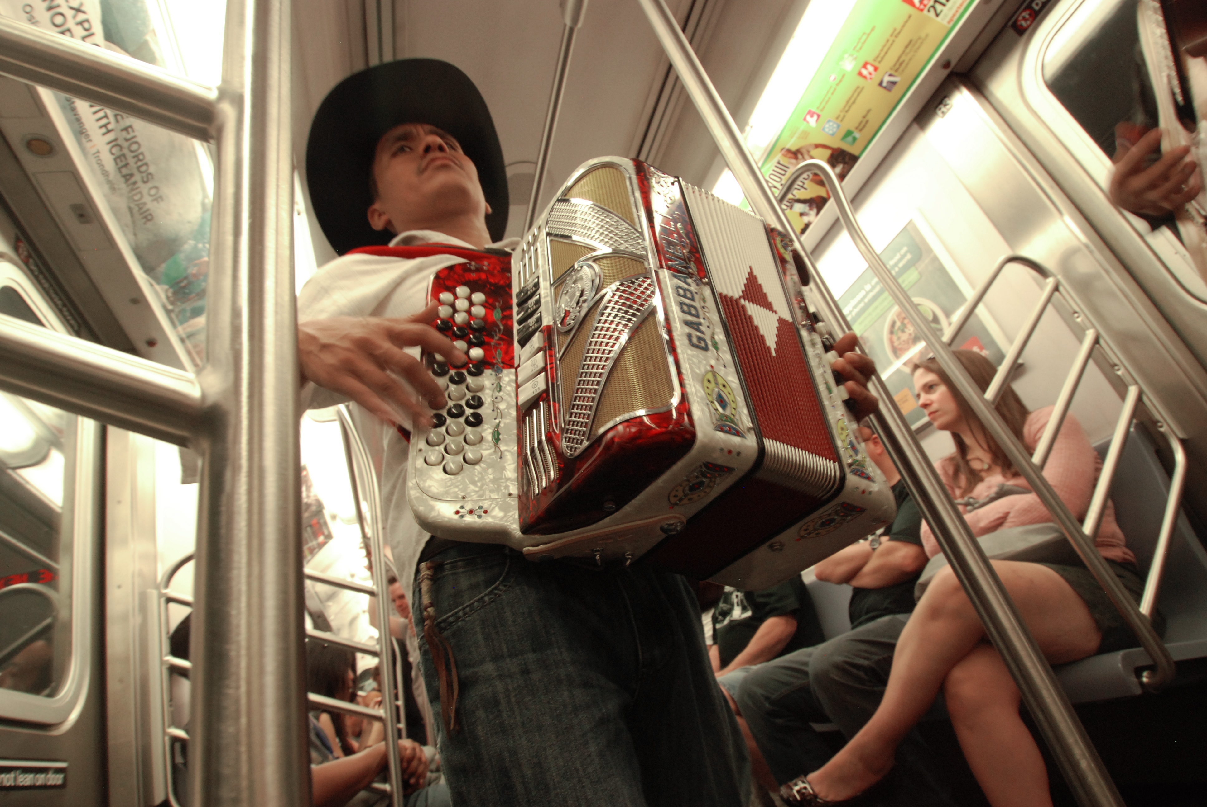
Performing
Sleeping

Slide 9
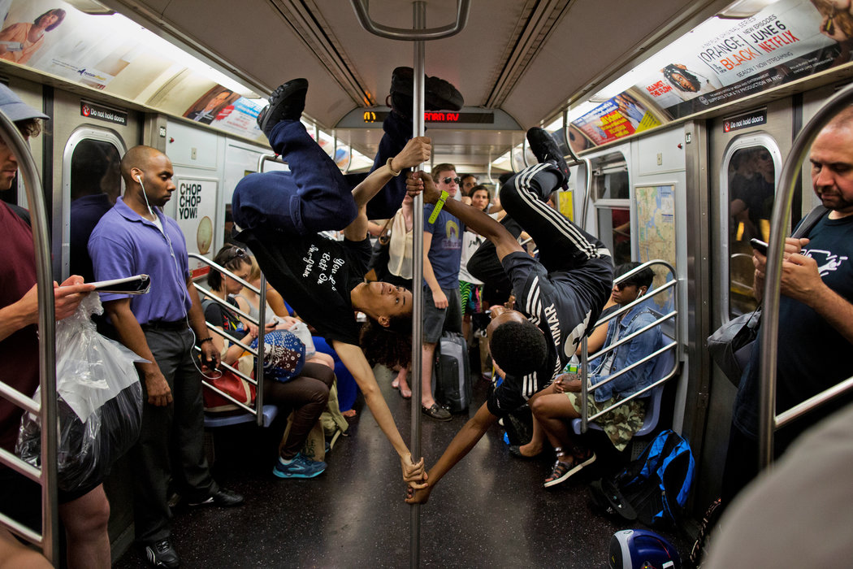
Dancing

Slide 10
Music shows

Slide 11
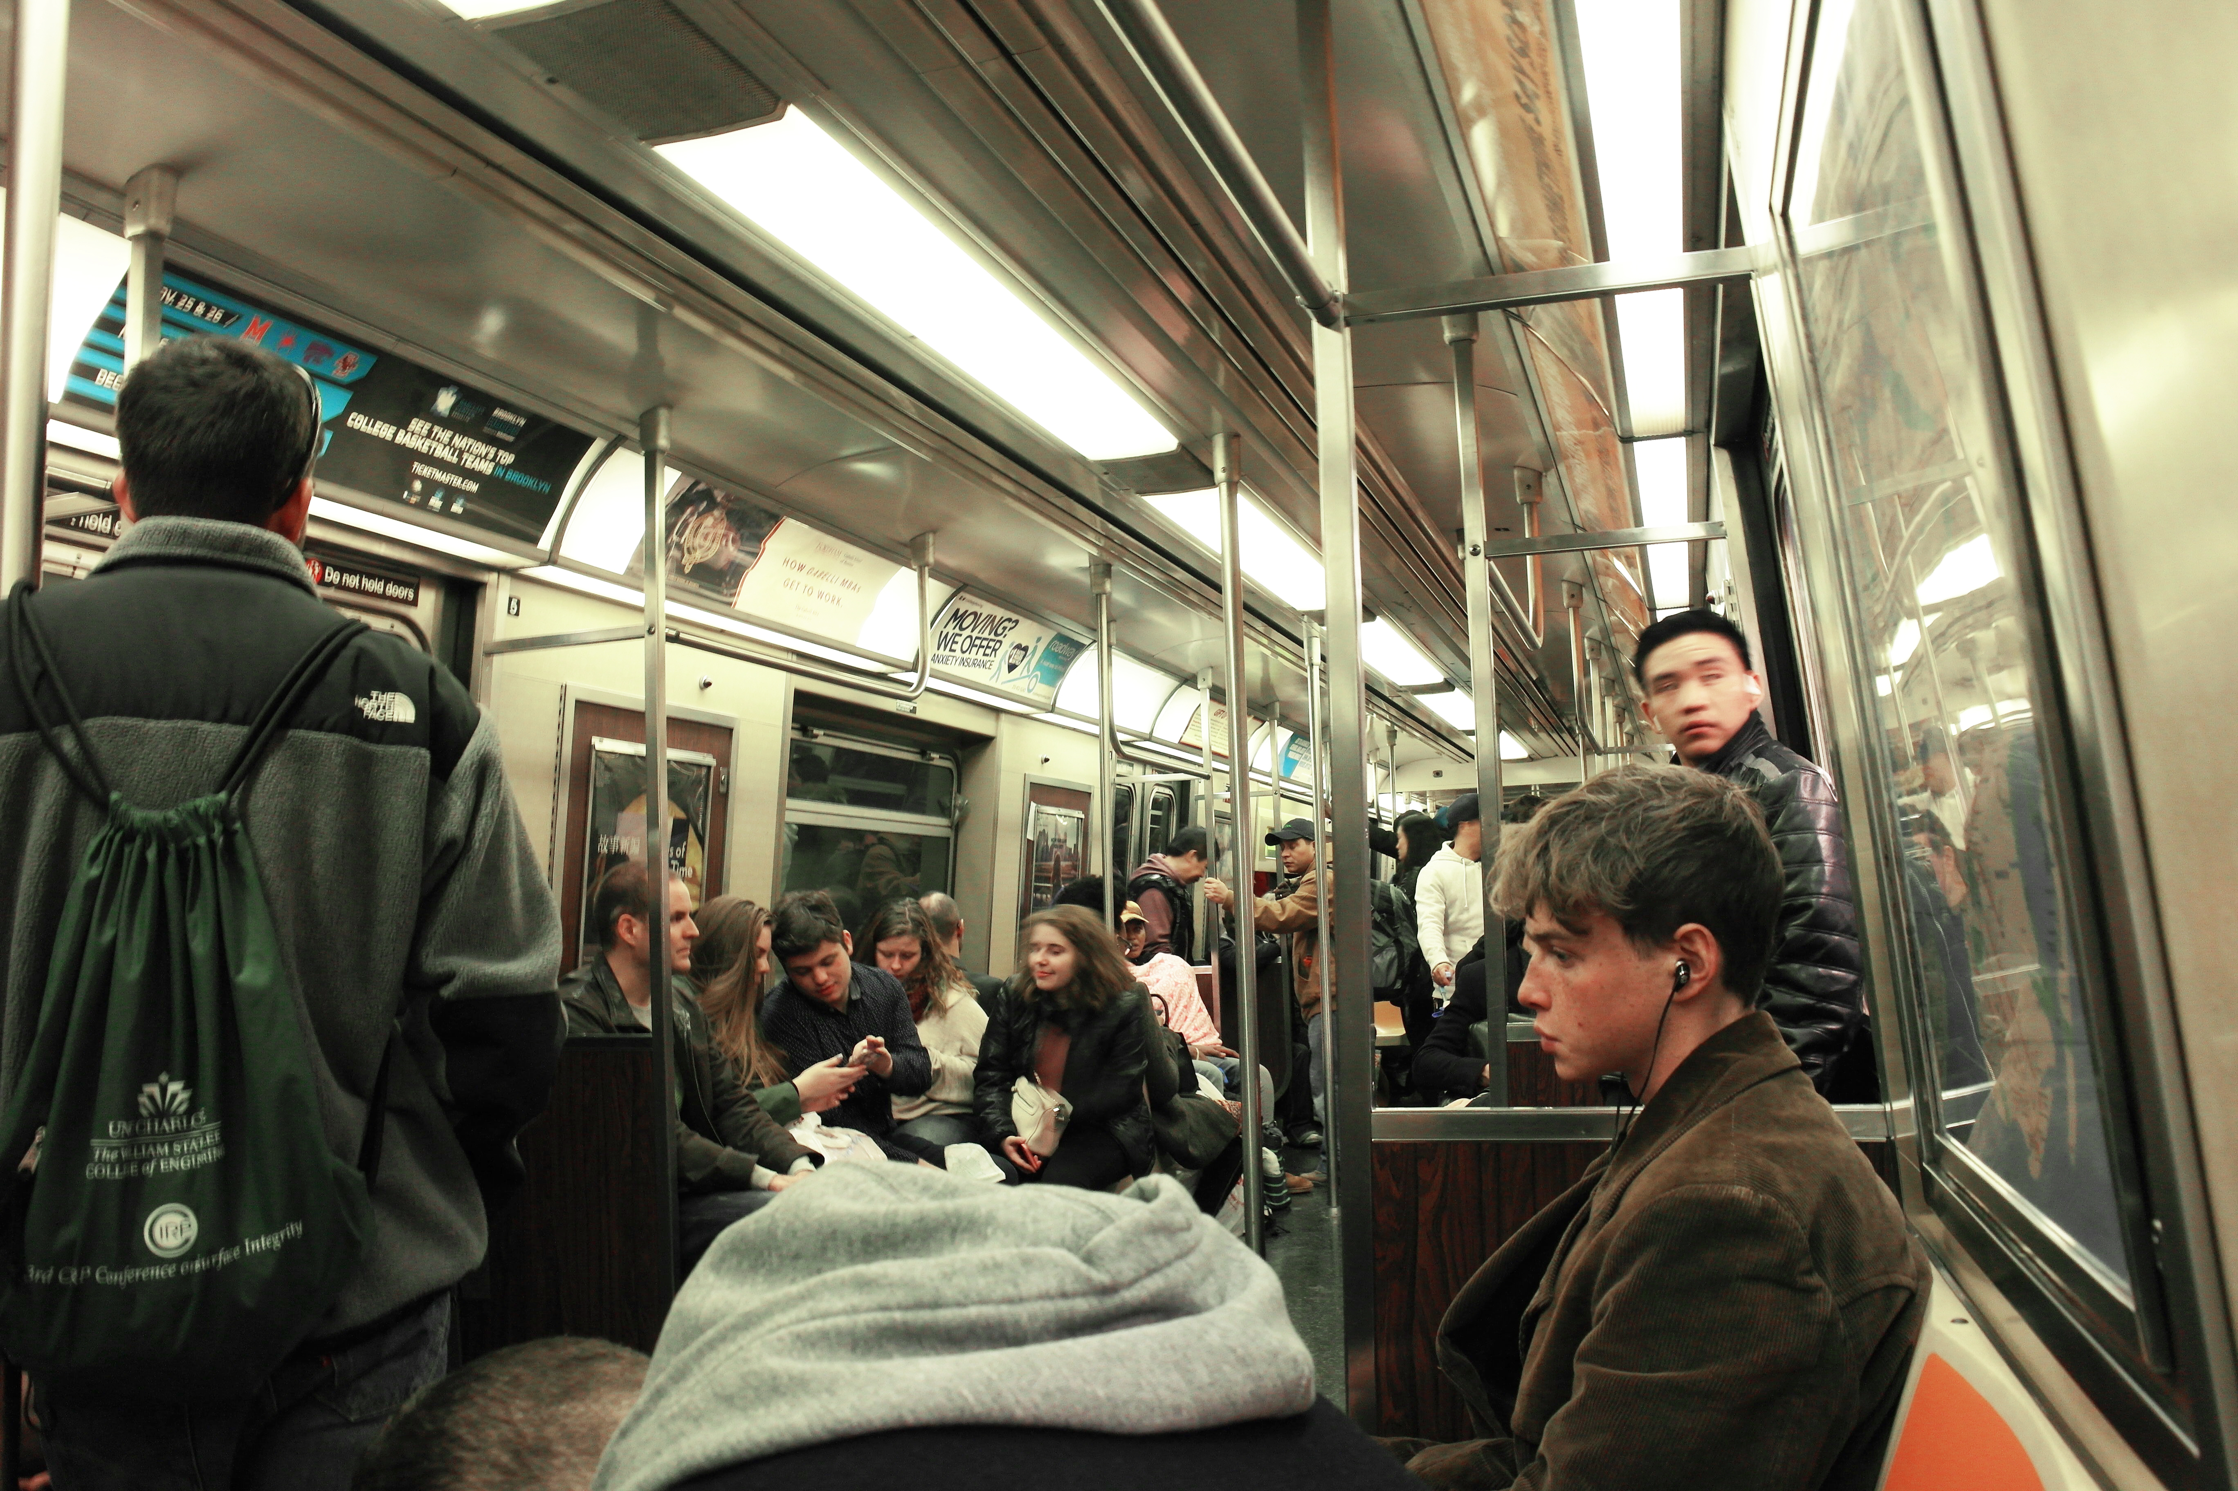
Socializing…
or alone time

